Slide 1

Capstone Project Netflix Movies and TV-Show Clustering by Aashish Thakur Mrityunjay Dubey Satyajit Sahoo Manish Jha

Slide 2

Content
About the dataset
Agenda
Dataset Summary
Data Cleaning
Distinguishing Features
Analysis of dataset
EDA
Recommender Systems and Clustering
Conclusion
Tools Used

Slide 3

About the data
This dataset consists of tv shows and movies available on Netflix as of 2019. The dataset is collected from Flixable which is a third-party Netflix search engine.
In 2018, they released an interesting report which shows that the number of TV shows on Netflix has nearly tripled since 2010. The streaming service’s number of movies has decreased by more than 2,000 titles since 2010, while its number of TV shows has nearly tripled. It will be interesting to explore what all other insights can be obtained from the same dataset.
Integrating this dataset with other external datasets such as IMDB ratings, rotten tomatoes can also provide many interesting findings.

Slide 4
Agenda
In this project, you are required to do:-
Exploratory Data Analysis
Understanding what type content is available in different countries
Is Netflix has increasingly focusing on TV rather than movies in recent years.
Clustering similar content by matching text-based features

Slide 5
Dataset Summary
Given dataset contains information regardingthe movies and TV-Shows uploaded
by the streaming giant Netflix on their platform dataset has 7787 observation and
12 variables.
Show_id - Unique ID for every Movie / Tv Show
Type - Identifier - A Movie or TV Show
Title - Title of the Movie / Tv Show
Director - Director of the Movie
Cast - Actors involved in the movie / show
Country - Country where the movie / show was produced

Slide 6
Dataset Summary Cont..
date_added - Date it was added on Netflix
release_year- actual Release year of the movie / show
rating - TV Rating of the movie / show
duration - Total Duration - in minutes or number of seasons
listed_in - Genere
description - The Summary description

Slide 7
Exploratory Data Analysis
1.Checking for Null Values.
2. Checking if TV-Shows have repetitions as different seasons.
3. Top 10 director (by number of movies directed), their country and their type of work.
4. Top 10 countries which produces most number of content.
5. Top 10 actors (by number of movies appeared in).
6. Top 10 countries producing most number of movies.
7. When movies are added to Netflix ?
8. How movies and TV-Show ratings changed over the years.

Slide 8
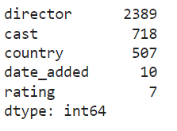

Exploratory Data Analysis
1.Checking for Null Values.
2. Repetition in TV-Shows,
as different seasons.

Slide 9
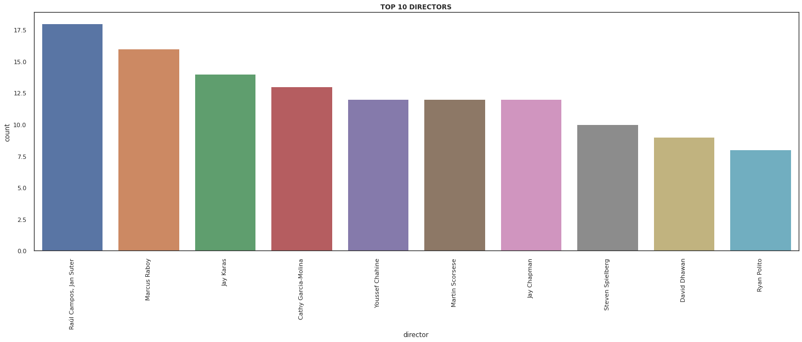
Exploratory Data Analysis
Top 10 director (by number of movies directed), their country and their type of work.

Slide 10
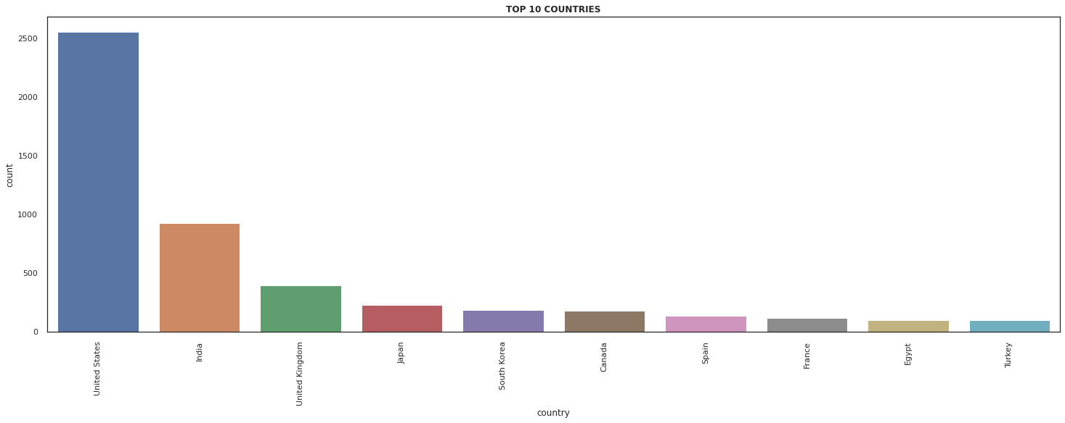
Exploratory Data Analysis
Top 10 countries which produces most number of content.

Slide 11
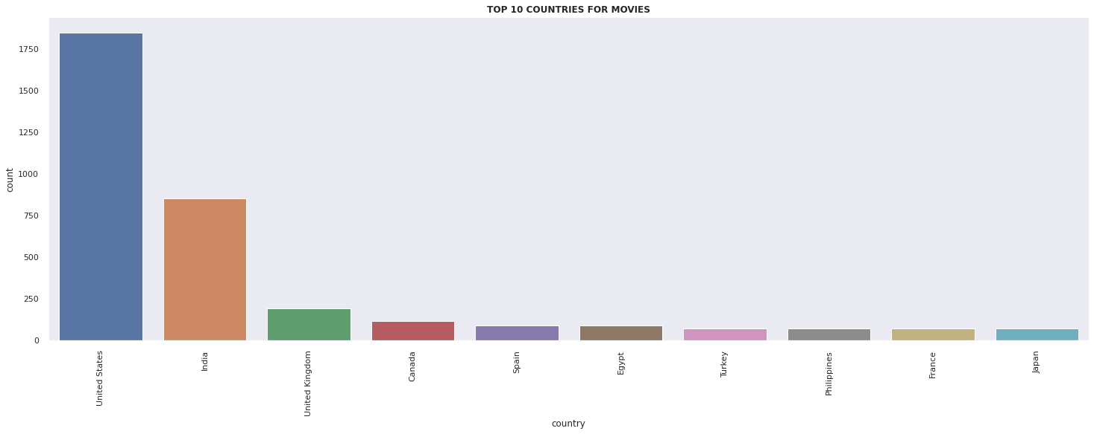
Exploratory Data Analysis

Slide 12
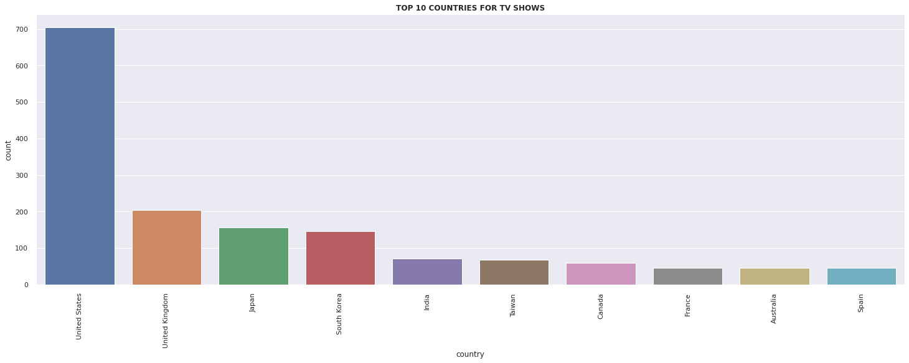
Exploratory Data Analysis

Slide 13
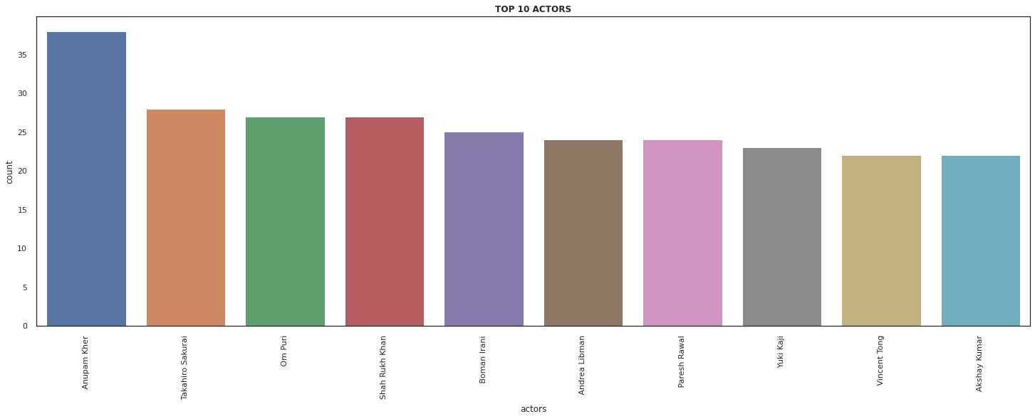
Exploratory Data Analysis
Top 10 actors

Slide 14
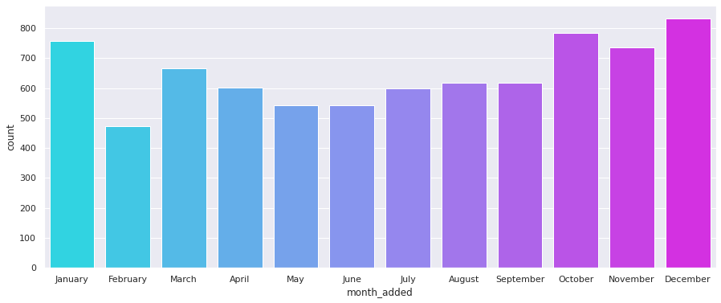
Exploratory Data Analysis
When movies are added to Netflix

Slide 15
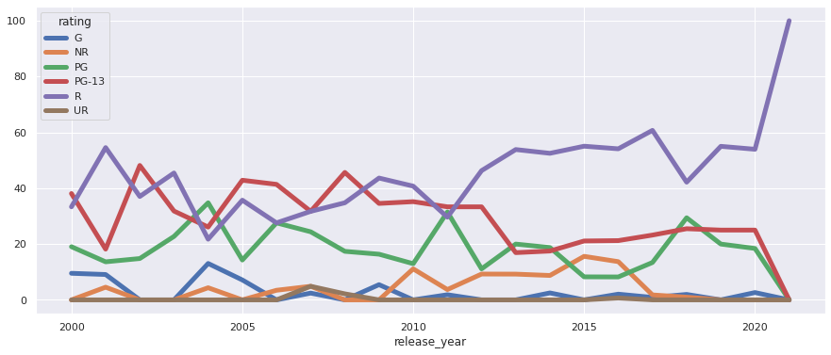
Exploratory Data Analysis
How rating has changed over the years.

Slide 16
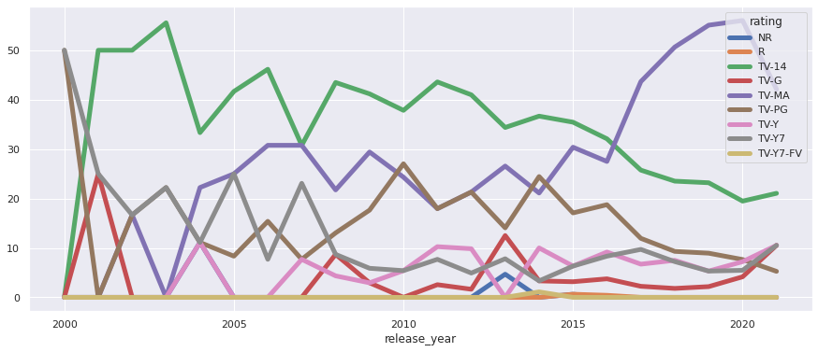

Slide 17
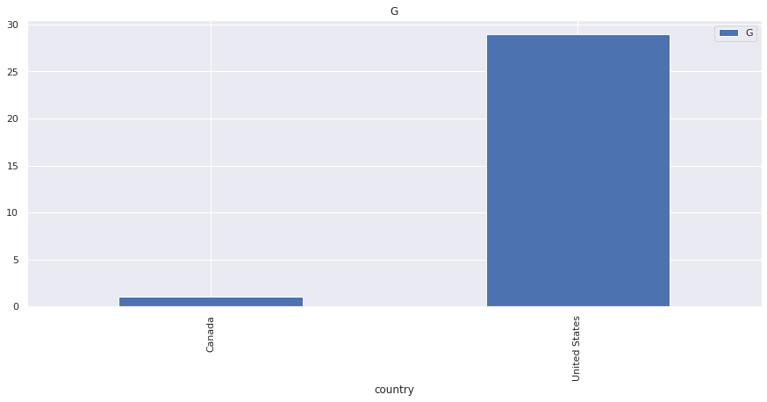
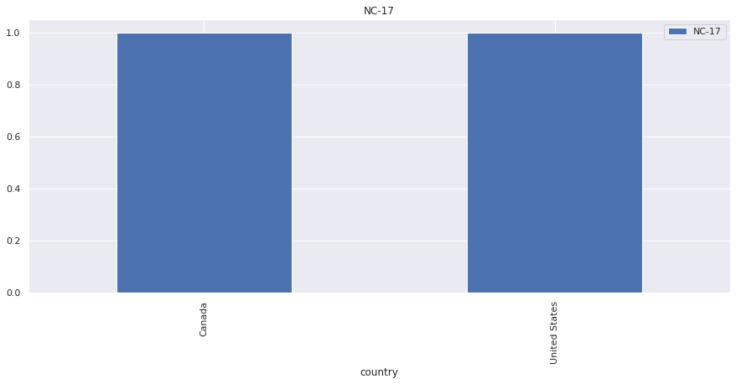
Type of Contents in different countries
Rating vs countries

Slide 18
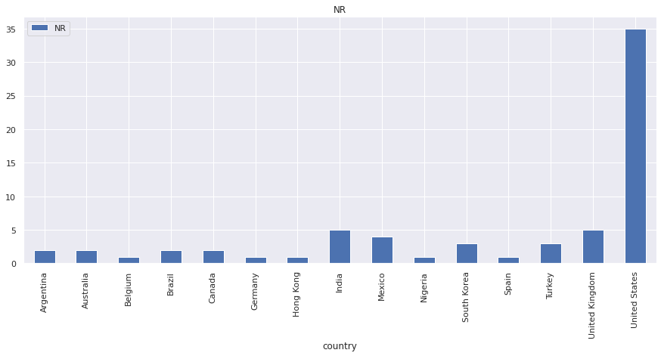
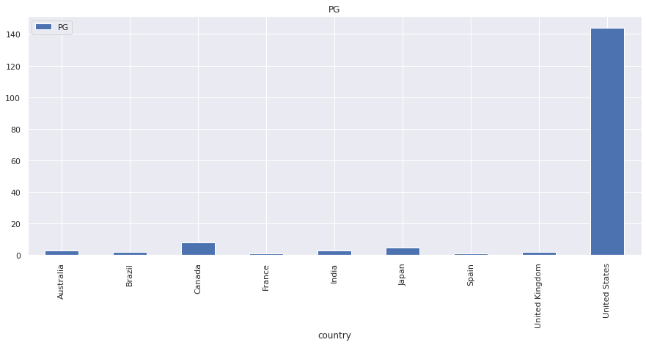
Type of Contents in different countries
Rating vs countries

Slide 19
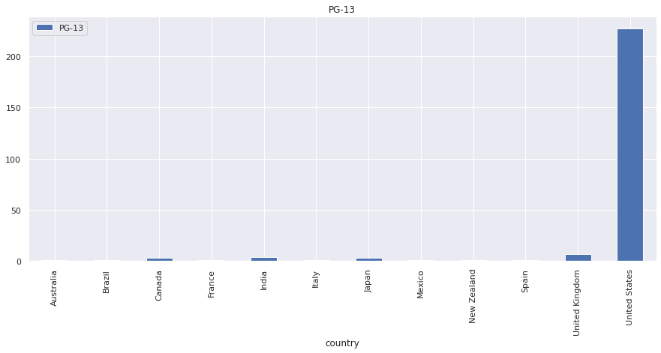
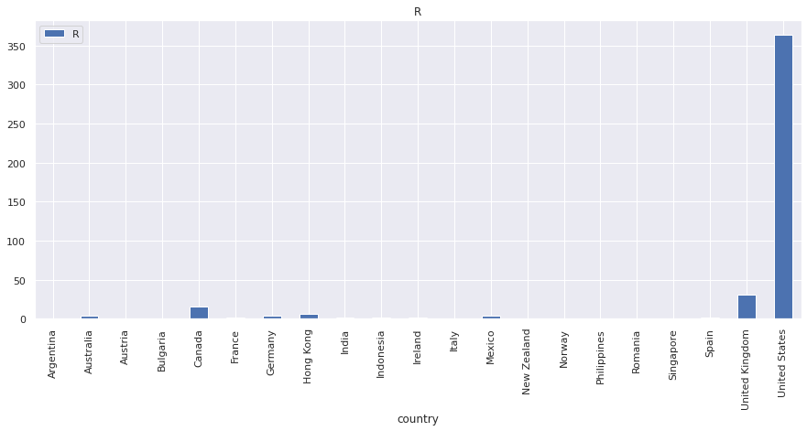
Type of Contents in different countries
Rating vs countries

Slide 20
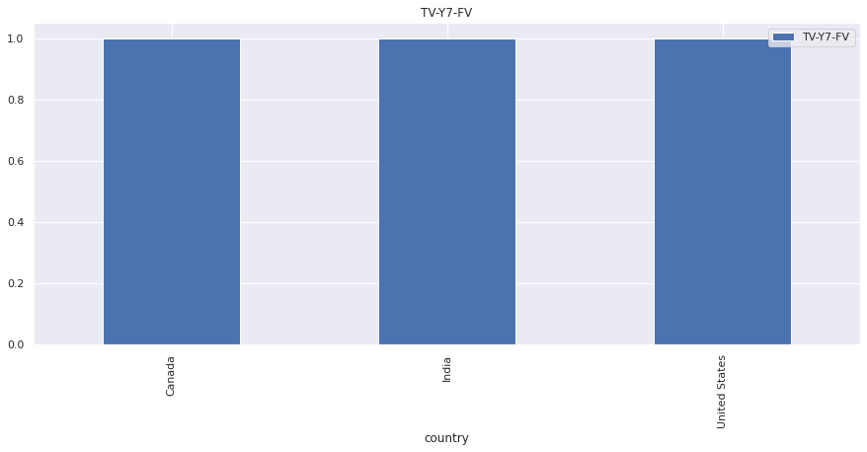
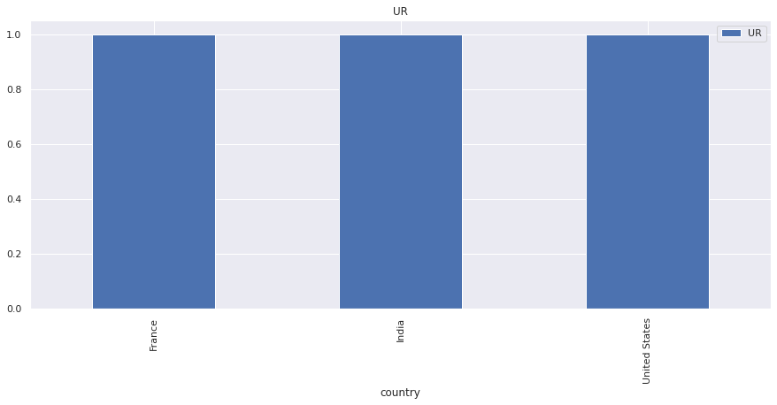
Type of Contents in different countries
Rating vs countries

Slide 21
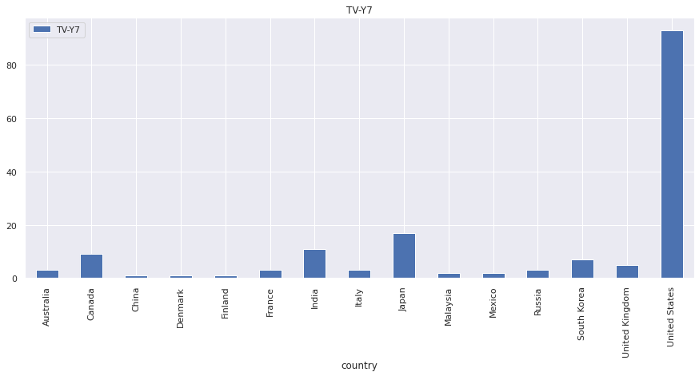
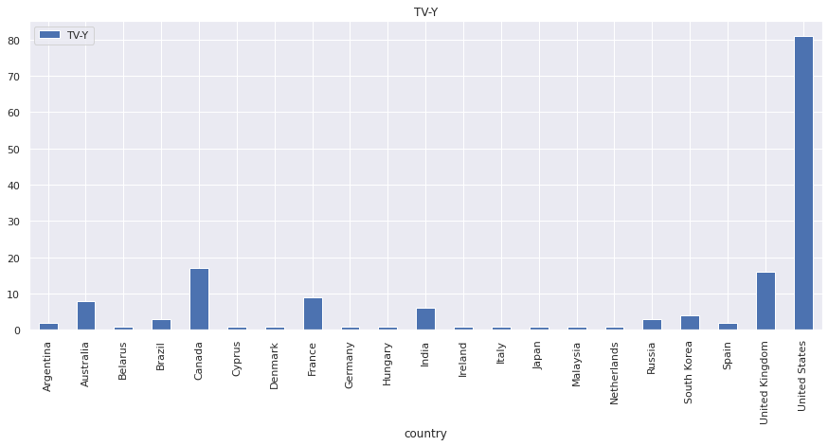
Type of Contents in different countries
Rating vs countries

Slide 22
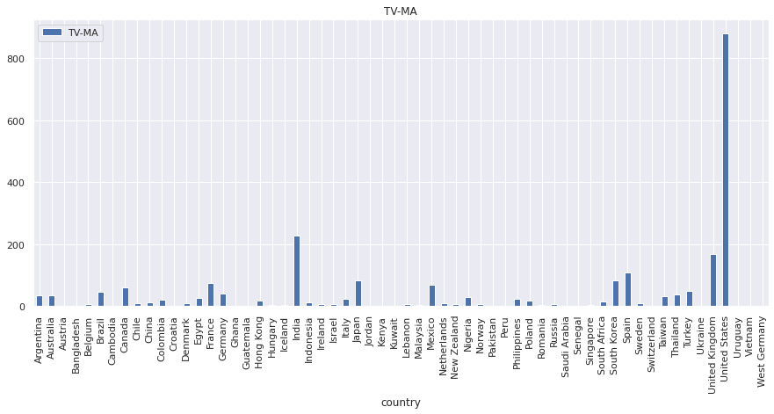
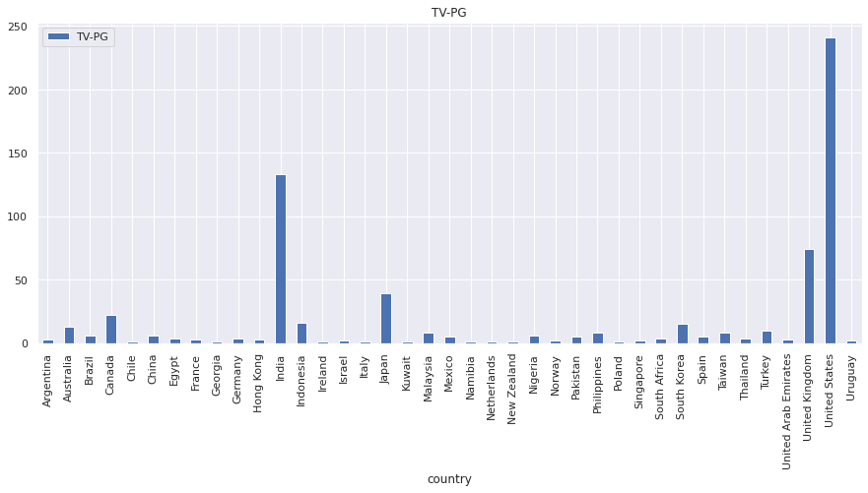
Type of Contents in different countries
Rating vs countries

Slide 23
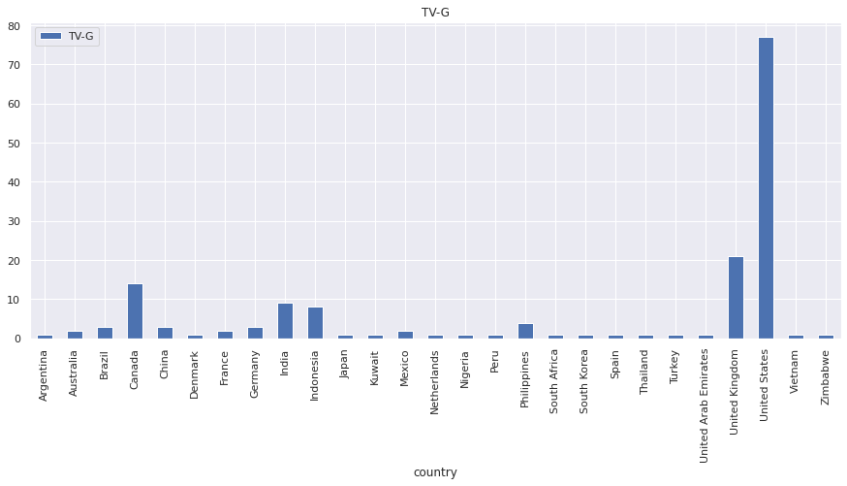
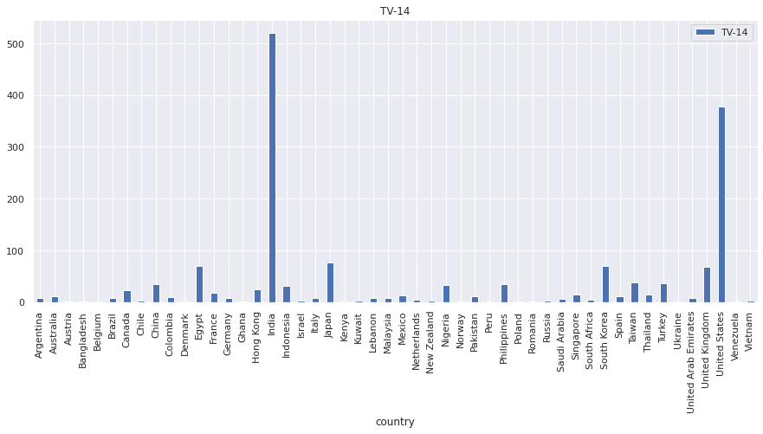
Type of Contents in different countries
Rating vs countries

Slide 24
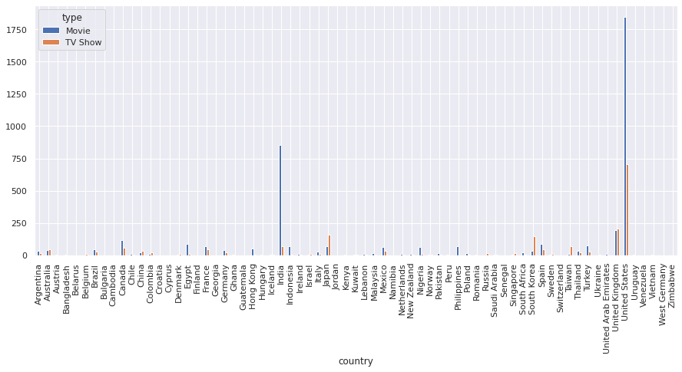
Type of Contents in different countries
Tv shows and movies

Slide 25
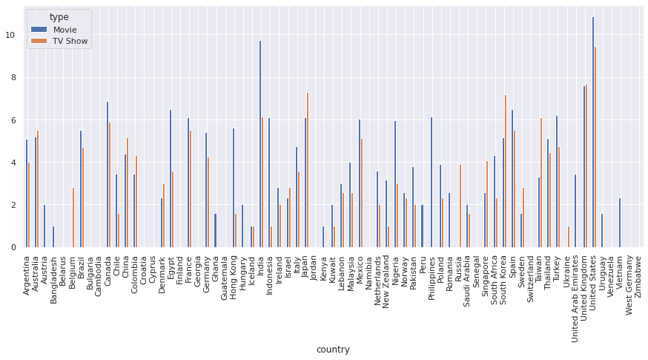
Type of Contents in different countries
Tv shows and Movies

Slide 26
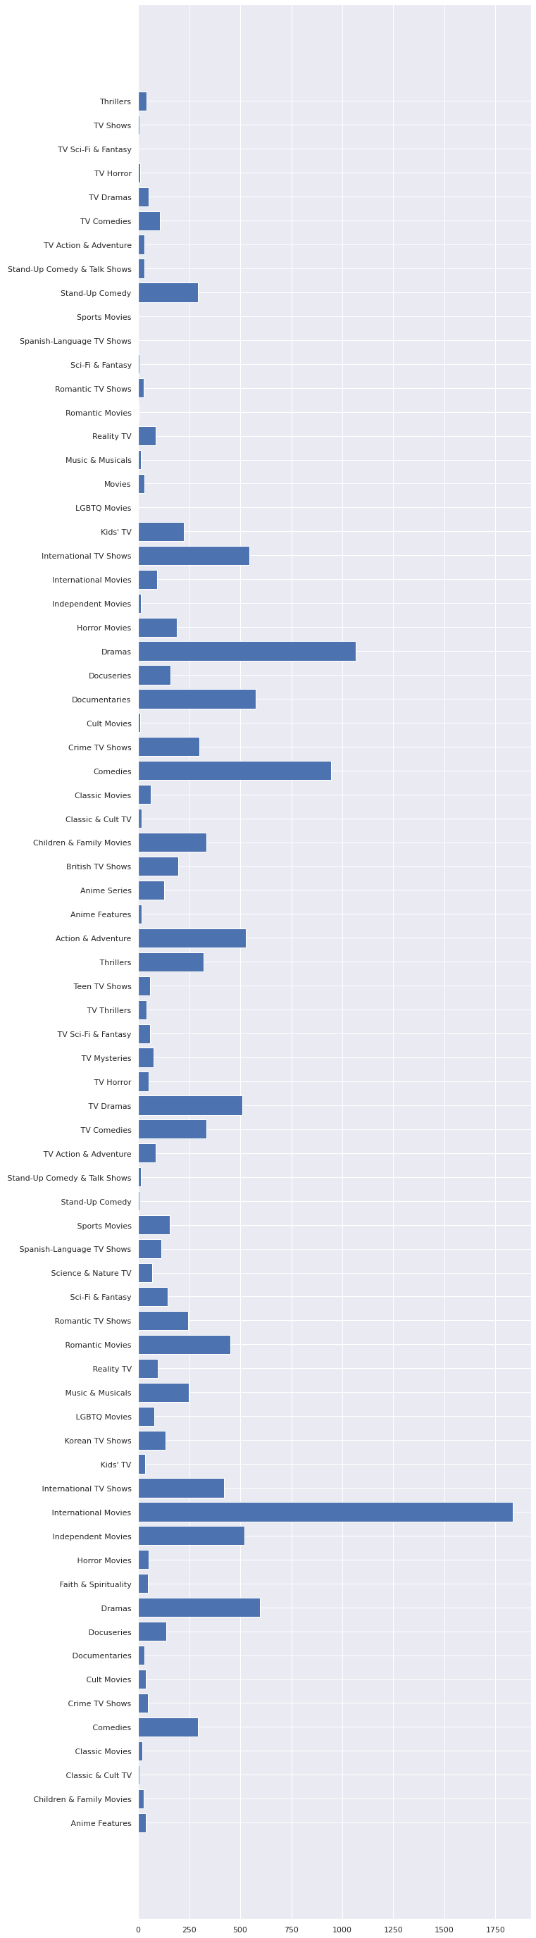
Content available by genre
Genre

Slide 27


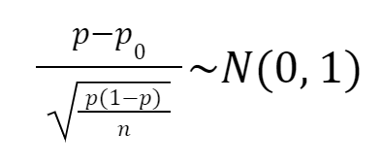
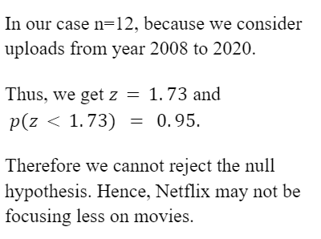
Has Netflix been focussing more on TV-Shows rather than Movies

Slide 28
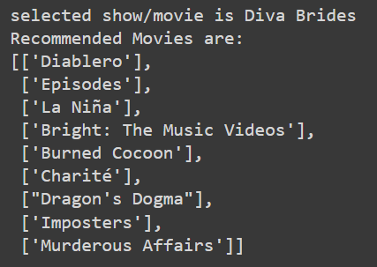
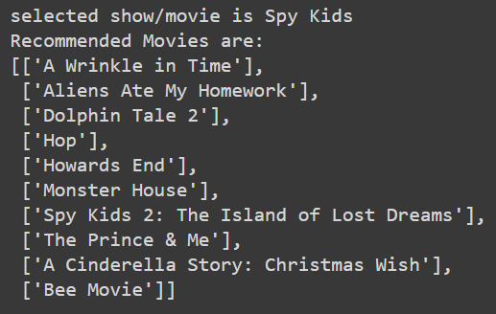
Recommender systems and Clustering
K-Nearest Neighbours approach based on content type and genres only.

Slide 29
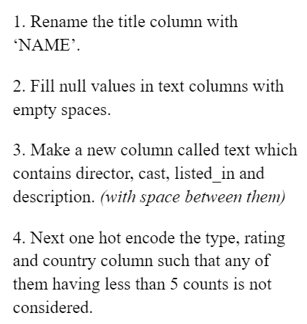
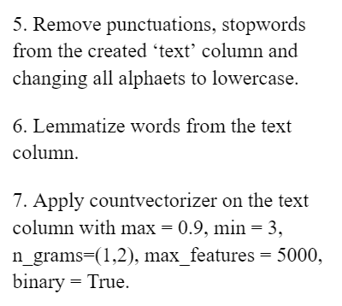
Recommender systems and Clustering
Text pre-processing

Slide 30
Recommender systems and Clustering
DBScanand K-Means Clustering
After processing the text columns we get 5788 columns, so we avoid applying any of the hierarchical clustering algorithms as most of the observations will form their own cluster.
We implement DBScan but due to high dimensionality most of the observations are marked as outliers.
We apply K-Means clustering with k=175, the results are good but R-Rated and G-Rated contents were in the same cluster. Moreover, there is no ranking, we are just clubbing similar content together, but many times the content don't turn out to be similar.

Slide 31
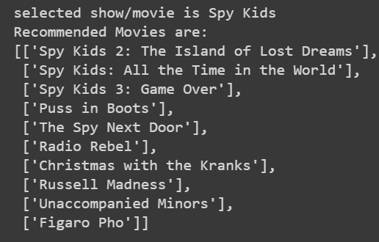
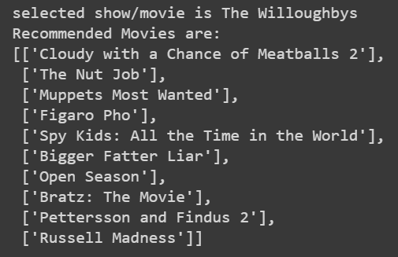
Recommender systems and Clustering
K-Neighbours on the improved dataset
We applied k-Nearest Neighbours on the improved dataset and it works really well.

Slide 32
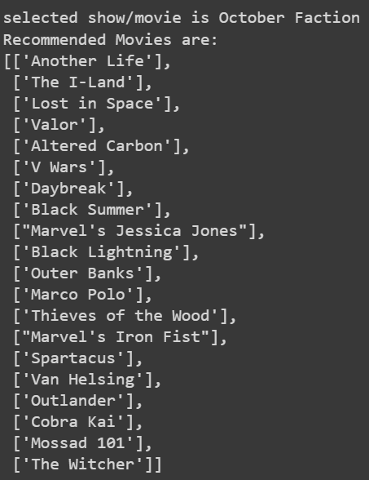
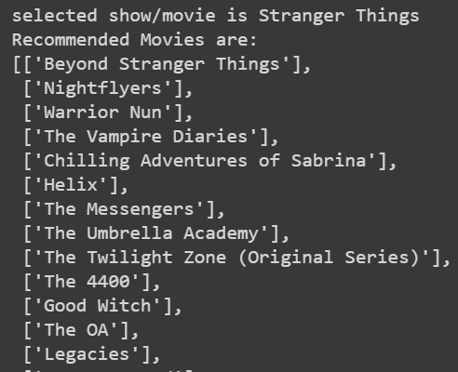
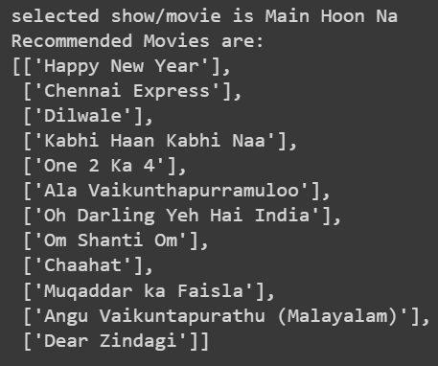
Recommender systems and Clustering

Slide 33
Conclusion
By exploring the given Netflix dataset we have drawn many out many information. Some of them are listed below:
USA and India contribute for most of the content available in this dataset.
The pair Raúl Campos, Jan Suter directed highest number of content available in this dataset. They have directed standup-comedy movies based out of south american countries like 'Mexico','Colombia','Argentina','Chile.
Anupam Kher and many other indian actors featured in a lot of movies in the dataframe but no indian director is present in the top director list. So, we may infer that a lot of missing entries in director column are regarding indian movies.
From this data we see that by a small margin the number of content added in Netflix increases at the end of the year. Which is evident because of indian and western festivals and holidays around that time
There is an increase of R-Rated movies and decrease in PG-13 movies between 2008 and 2021
Adventure, Drama, Comedy are the most famous genres.

Slide 34
Tools Used
Google Colaboratory
Python
github
Libraries imported:
Pandas
Numpy
Matplotlib
Seaborn
Various ML Libraries like DBSCAN, Kmeans, etc..

Slide 35
Thank You

